Slide 1

Intro to C++

Slide 2
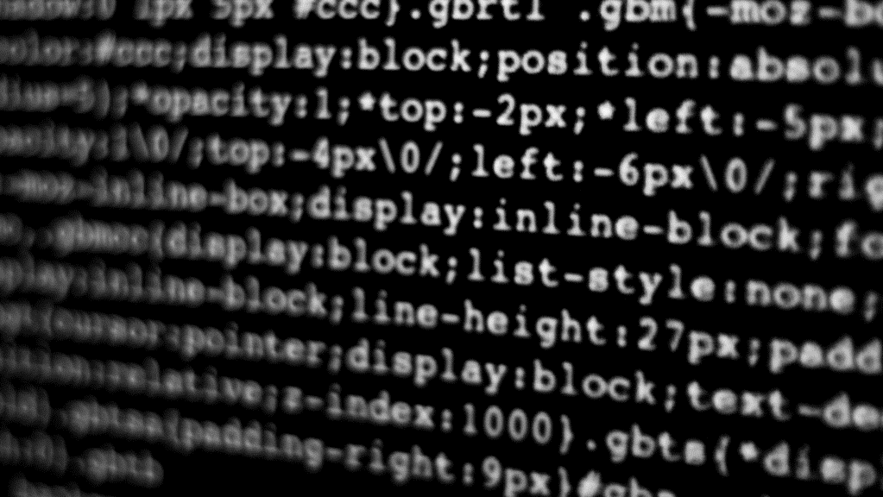
What is C++?

Slide 3
C++
One of the most popular languages for desktop applications
The most popular language for writing video games
Created by Bjarne Stroustrup, C++ is built on top of the revolutionary C programming language.

Slide 4
Why C++?
It’s FAST: If used correctly, it can be used to write incredibly efficient programs.
It’s Flexible: It can be used for many types of programming, including Object Oriented Programming.
It’s Well Supported: It’s been around for a long time. It’s old, and it’s still used. That means there are a lot of tools, tricks and tutorials on how to use it.

Slide 5

C++ SpeeD

Slide 6

C++ Speed

Slide 7
Why is C++ Fast?
C++ is a compiled programming language. This by itself doesn’t make it faster then other languages, but it makes it faster then many others.
It is barebones. Due to its structure, it doesn’t have some features that make programming with it easier. Those features can make programs run slower.
It’s a “low level” language, meaning you can directly manipulate memory allocation.

Slide 8
C++ is a low-level language
C was one of the first programming languages that could “easily” be read by humans. It only had one level of abstraction from machine language, so it is fast. It lacked a lot of features, making building complex software difficult.
C++ has some of those features but is still very close to machine language.

Slide 9

Why do we care if it’s fast
Games need to handle a lot of calculations just to make something show up on screen, not even including actual gameplay.
And it has to do it 60+ times a second.

Slide 10
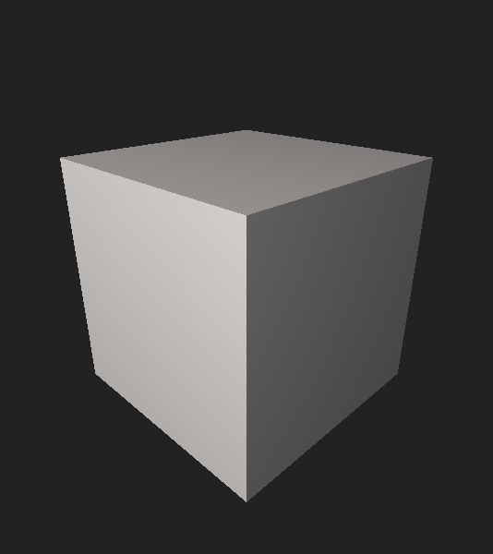
A Basic Cube
6 sides

Slide 11
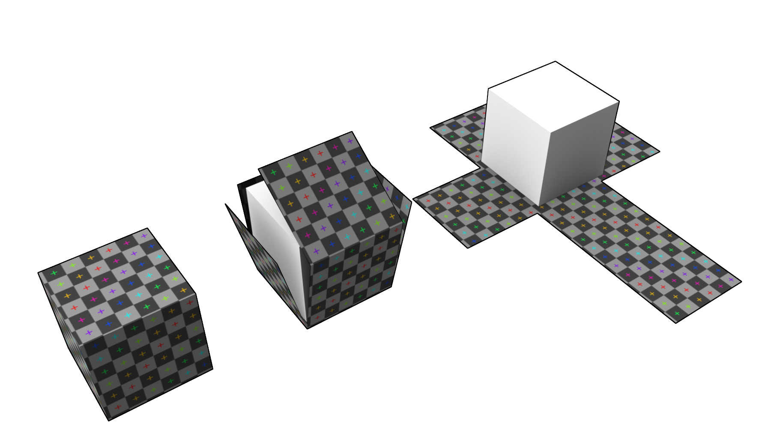
Each Side is a square

Slide 12

Each Square is made of 4 lines
Each edge is shared by 2 different sides.

Slide 13
Each corner has a Vertex (Vert)
The verts are represented in 3D space by X,Y and Z coordinates.

Slide 14
So a 3D model of a cube is really just…
(0,1,1)
(0,0,1)
(1,1,1)
(1,0,1)
(0,0,1)
(1,0,1)
(1,0,0)
(0,0,0)
(0,1,0)
(1,1,0)
(1,1,1)
(0,1,1)
(0,1,0)
(0,0,0)
(1,1,0)
(1,0,0)

Slide 15
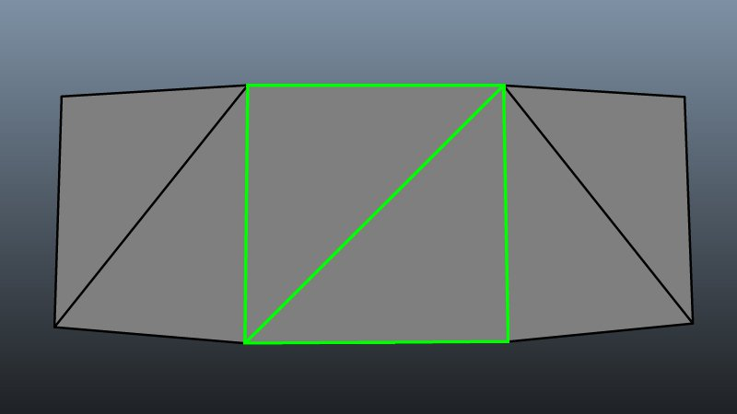
Except we don’t usually use 4 sided polygons
For a bunch of different reasons, 3D modelers / Game Devs prefer 3 sided polygons.

Slide 16
for ½ of a side, we have this matrix
[0, 0, 1, 1]
[0, 0, 0, 1]
[1, 0, 0, 1]
[1, 1, 1, 1]
And this doesn’t include UVWST coordinates.
Each vertex is actually X, Y, Z, U, V, W, S, T
Most modern game models have hundreds of thousands of triangle polygons.
And the calculations involved in just rotating a simple cube can get incredibly complex.
The math is simple (adding, subtracting and multiplying), but you have to do A LOT of them.

Slide 17
Because C++ let’s us have a lot of control…
We can fine tune our code to best take advantage of memory and the direct power of processors to handle things more quickly and efficiently.
This is slightly less important as we have drastically more powerful machines, but often, a lot of small inefficiencies add up.

Slide 18
An example
Each Boolean variable takes up a whole byte in memory, even though it’s only ever true or false:
        0000 0000 or 0000 0001
        Though some tricks that we can use because of the low-level nature of C++, we can combine 8 different Booleans into 1 byte
        1011 1001

Slide 19
Ok, we get it. C++ does things fast

Slide 20
https://cpp.sh/

Slide 21
How a C++ File is processed
Editor
Source Code
Before learning the language, we need to know a bit about how a C++ file is actually run.
C++ is a compiled language, which means it has to be fully processed before running
Compiler
Machine Language
Linker
Executable File

Slide 22
Compiled vs. Interpreted Languages
Compiled:
Code is converted directly into machine code, which the processor can then execute.
This results in faster and more efficient code that can be executed multiple times.
Compiled programs can only run on computers with the same architecture as the computer they were compiled on.
Interpreted:
Code is translated and executed line by line each time the program is run.
This makes it easier and quicker to develop and test code.
Less efficient than compiled programs because they need to be translated every time they are run.

Slide 23
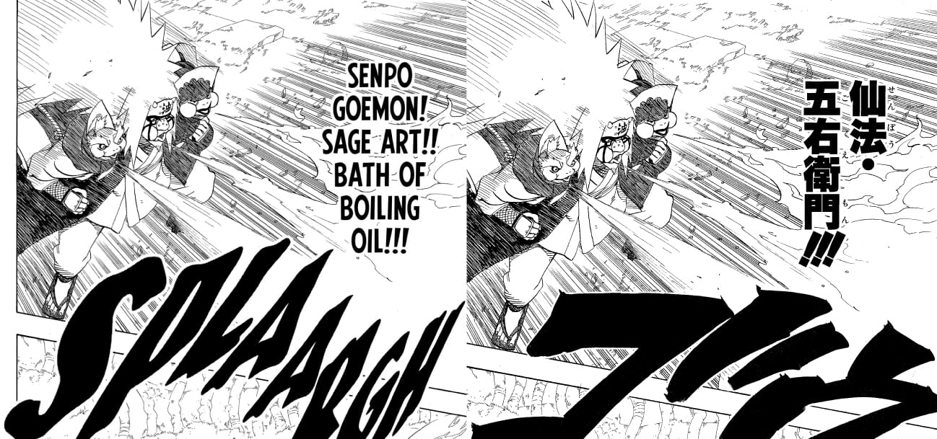
Compiled Languages
Imagine a translator having to retranslate every single copy of a manga that gets sold.
Better to translate once, then take the time to package it, send it out, then print out copies of that original translation.
Sure, this make take longer to make the first copy, but once it’s running, it’s a lot faster.
“Pay now to save later”

Slide 24

Editor & Source Code
Editor
Source Code
We will be using Visual Studio (Not Visual Studio Code)
You write the source code in C++
Compiler
Machine Language
Linker
Executable File

Slide 25
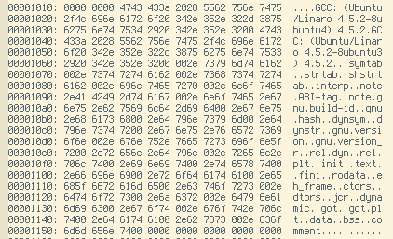
Compiler & Machine Language
Editor
Source Code
We pass the source code to the Compiler (we compile it).
It takes your code and transforms it into executable machine code files. It does some optimization and arranges things.
Compiler
Machine Language
Linker
Executable File

Slide 26
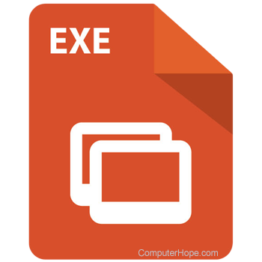
Linker & Executable
Editor
Source Code
The Compiler only compiles the exact code you give it. Most of the time, you will reference other files / libraries / functions.
The Linker “links” everything in order, which then produces an Executable File.
Compiler
Machine Language
Linker
Executable File

Slide 27

So… we have to learn all these tools????

Slide 28

Our IDE Has this all built in
Visual Studio handles it all for us.
All we need to do is have it setup, and then when we want to run our code, we have to “Build” it.
This creates the extra files needed each time. (more on that later)

Slide 29
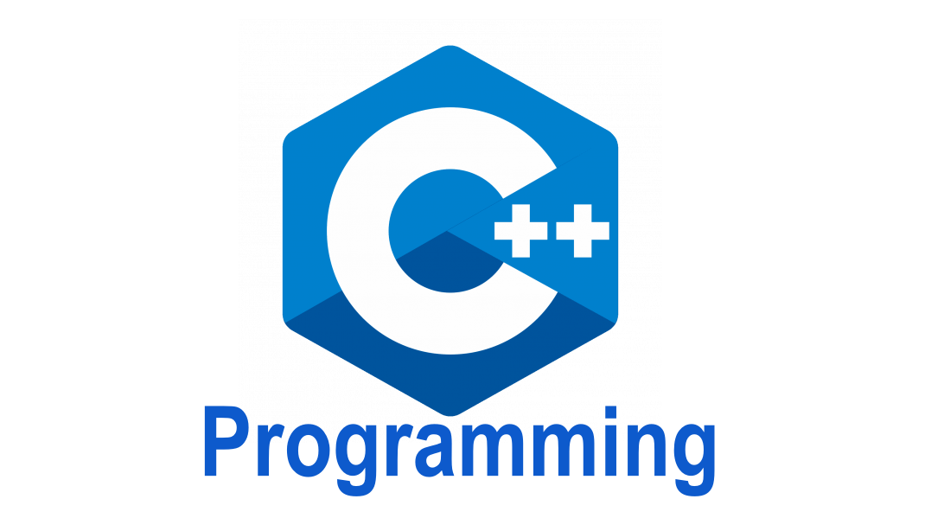

Slide 30
Disclaimer:
We Will be focusing on C++ as it relates to Unreal Engine.

Slide 31
Our First C++ Program
// Example program
#include <iostream>
#include <string>
int main(){
std::cout << "Hello World!" << std::endl;
return 0;
}
A simple program that prints “Hello World” to the console.

Slide 32
Our First C++ Program
// Example program
#include <iostream>
#include <string>
int main(){
std::cout << "Hello World!" << std::endl;
return 0;
}
A comment.
Very important for documentation.
Ignored by the compiler.
Leave notes to yourself and others.

Slide 33
A Quick Note about Whitespace
The compiler ignores blank lines, called “whitespace”.
This includes things like spaces, tabs and new lines.
Take advantage of this while writing code to group things together in logical ways.

Slide 34
Our First C++ Program
// Example program
#include <iostream>
#include <string>
int main(){
std::cout << “Hello World!" << std::endl;
return 0
}
#include statement.
Used to pull in code from other files, specifically header files.

Slide 35
Our First C++ Program
// Example program
#include <iostream>
#include <string>
int main(){
std::cout << "Hello World!" << std::endl;
return 0;
}
iostream
Part of the C++ Standard Library, used to help display input and output
Not used in Unreal

Slide 36
Our First C++ Program
// Example program
#include <iostream>
#include <string>
int main(){
std::cout << "Hello World!" << std::endl;
return 0;
}
string
Part of the C++ Standard Library, used to handle strings (not included in base C++ features)
Not used in Unreal

Slide 37
Our First C++ Program
// Example program
#include <iostream>
#include <string>
int main(){
std::cout << "Hello World!" << std::endl;
return 0;
}
main()
ALL C++ PROGRAMS MUST HAVE A FUNCTION MAIN() AS THE STARTING POINT FOR THE PROGRAM

Slide 38
Our First C++ Program
// Example program
#include <iostream>
#include <string>
int main(){
std::cout << “Hello World!" << std::endl;
return 0
}
int main()
main() function returns an integer when it’s done. 0 if there are no errors (more on that later)

Slide 39
Our First C++ Program
// Example program
#include <iostream>
#include <string>
int main(){
std::cout << "Hello World!" << std::endl;
return 0;
}
{ and }
Mark the beginning and end of a code block found inside of a function.

Slide 40
Our First C++ Program
// Example program
#include <iostream>
#include <string>
int main(){
std::cout << "Hello World!" << std::endl;
return 0;
}
<<
Output operator: Sends the string to cout.
Funnels from the open side into the pointy side.

Slide 41
Our First C++ Program
// Example program
#include <iostream>
#include <string>
int main(){
std::cout << "Hello World!" << std::endl;
return 0;
}
std
A namespace that indicates that we are referring to the cout in the standard (std) library.

Slide 42
NAmespace
It’s like an area code.
2 people can have the same phone number: 867-5309
We use Area codes to as an extra way to indicate “do we mean the 867-5309 in Southside Chicago (773) or in San Francisco (415)
Namespaces let us have functions with the same name as other libraries without worrying about it

Slide 43
Our First C++ Program
// Example program
#include <iostream>
#include <string>
int main(){
std::cout << "Hello World!" << std::endl;
return 0;
}
::
Scope Resolution Operator: Basically says “Look in here for this”

Slide 44
Our First C++ Program
// Example program
#include <iostream>
#include <string>
int main(){
std::cout << "Hello World!" << std::endl;
return 0;
}
endl
End Line.
Like pressing the enter key

Slide 45
Our First C++ Program
// Example program
#include <iostream>
#include <string>
int main(){
std::cout << "Hello World!" << std::endl;
return 0;
}
;
Statement termination.
Like a period at the end of a sentence

Slide 46
Let’s go run the code

Slide 47
Our First C++ Program v2
// Example program
#include <iostream>
#include <string>
using namespace std;
int main(){
cout << "Hello World!" << endl;
return 0;
}
using namespace …
Tells the compiler “whenever we have something that might be from std, then assume it’s from std, so bring it all in”
Note that we don’t have to do std::endl anymore

Slide 48

Time for some Review

Slide 49

Data Types
C++ is strongly-typed, which means that when working with data, you must define the TYPE of data that it is.
  EX: 13 and “13” are not the same

Slide 50
Numerical Data Types
int
  Integer numbers (whole numbers)
  EX: 3
  Has a max value, but you can’t have rounding errors
float
  Floating Point (decimal) numbers.
  EX: 3.14
  Has a max value, but can give you rounding errors
    3.0 is not the same as 3.0000000000000001
int age = 25;
float height = 5.9f;

Slide 51
Boolean Data Type
bool
  Boolean is either true or false.
  That’s it.
  Useful for flags, such as isAlive or player is connected
bool isGameDesigner = true;

Slide 52
Character Data Types
char
  A single character
  Not terribly useful for C++ but is necessary to use in other languages
  EX: ’a’
string
  A sequence of chars strung together, like words
  EX: “Alabama”
  EX: “Do or do not, there is no try”
  EX: “5”
char initial = 'A’;
string name = ”Miles";

Slide 53

There are more data types but that’s all we need for now
You can even make custom ones!

Slide 54
// Single Line Comment
Usage: Used for brief comments on a single line.
Example:
int x = 10; // This is a single-line comment

Slide 55
/* */ Multi Line Comment
Usage: Used for longer comments that span multiple lines.
Example:
/*
This is a multi-line comment.
It can span multiple lines.
*/
int y = 20;

Slide 56

Let’s Math it up

Slide 57
Operators
An operator is a symbol that tells the compiler to perform specific mathematical, logical, or relational operations on one or more operands (values or variables).
Basically… a symbol that does something.

Slide 58
Arithmetic Operators
+ (addition)
- (subtraction)
* (multiplication)
/ (division)
% (modulus) [returns the REMAINDER of a division]

Slide 59

I/O

Slide 60
Output with std::cout
std::cout << "Hello, world!" << std::endl;
std::cout is used for printing data to the screen.
Use std::endl or "\n" for new lines.
Note the Output operator <<
You can chain them together like so:
std::cout << "The sum of " << 5 << " and " << 3 << " is " << (5 + 3) << std::endl;

Slide 61
Reminder…
You can use using namespace std; to clean up your cin and cout.
#include <iostream>
using namespace std;
int main() {
cout << "Game Over“ << endl;
return 0;
}

Slide 62
input with std::CIN
std::cin >> age;
std::cin is used for getting input form the user.
You must store the input in a variable to use it
Note the Extraction operator >>
You have to pay careful attention to the DATA TYPE of the variable and the input

Slide 63
input with std::CIN
#include <iostream>
using namespace std;
int main() {
int age;
cout << "Enter your age: ";
cin >> age;
cout << "You are " << age << " years old." << endl;
return 0;
}

Slide 64
Practice
Write a program that takes the user’s name and age, then prints a message using those inputs.
Use https://cpp.sh/

Slide 65
Practice
Write a program that takes the user’s name and age, then prints a message using those inputs.
#include <iostream>
using namespace std;
int main() {
string name;
int age;
cout << "Enter your age: ";
cin >> age;
cout << "Enter your name: ";
cin >> name;
cout << "Your name is " << name << endl;
cout << "You are " << age << " years old." << endl;
return 0;
}

Slide 66

C++ Syntax

Slide 67
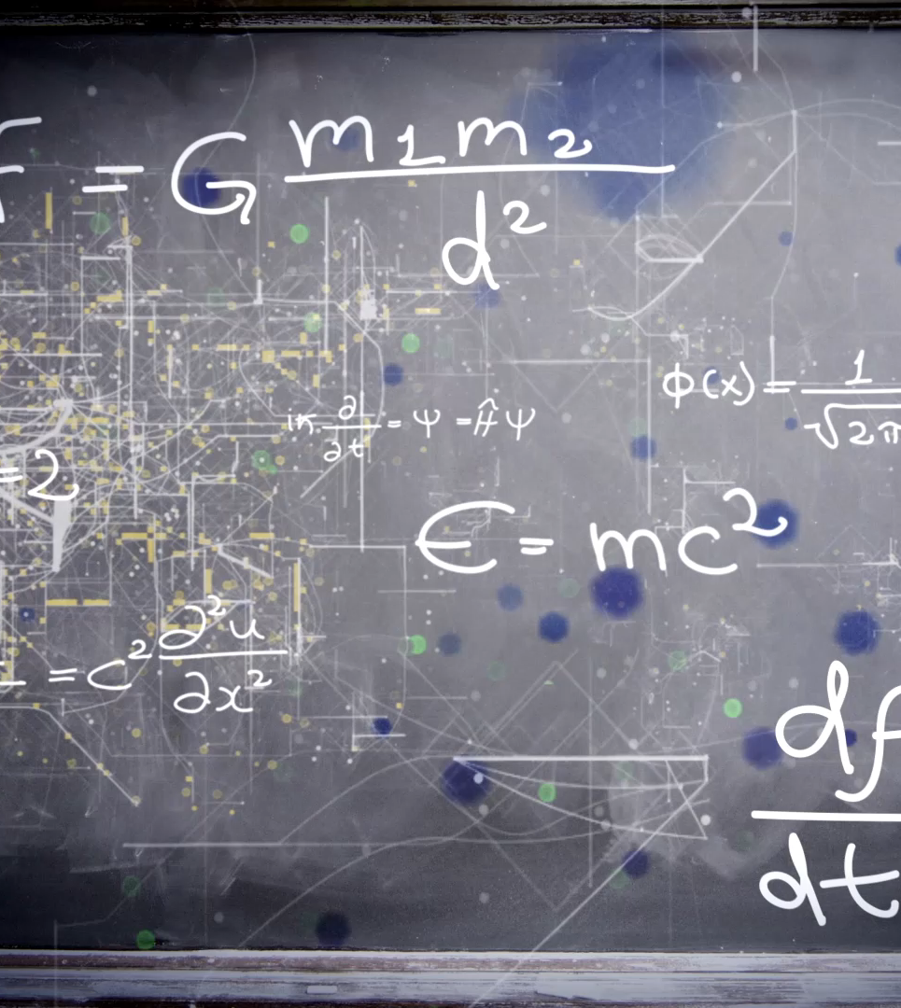
Syntax
The rules of the language, specifically regarding structure and punctuation.
They have Syntax in English and Spanish.
They also have it in every programming language.

Slide 68
C++ Syntax Rules
You must follow these if you want your code to run

Slide 69
Syntax Rule 1: Statements
Every C++ statement ends with a semicolon (;).
int x = 5;

Slide 70
Syntax Rule 2: Case-Sensitivity
C++ is case-sensitive.
Hello and hello are NOT the same.
int num = 10; // Correct
int Num = 10; // Different variable

Slide 71
Syntax Rule 3: Braces and Blocks
Curly braces {} define code blocks.
Must be used for function bodies, control structures, classes, loops...
You must match them in the proper order
if (x > 0) {
std::cout << "Positive number";
}

Slide 72
Syntax Rule 4: Variable Declarations
Variables must be declared before use.
The data type is required when declaring
int age = 20;

Slide 73
Syntax Rule 4: Spaces Between Matter
Spaces Matter
dateOfBirth will work.
Date of Birth won’t.
This is most important when it comes to variables and functions (which we will learn about later)
string dateOfBirth = "May 5th, 2021"; // correct
string date Of Birth = "May 5th, 2021"; // error

Slide 74
Syntax Rule 5: Spaces Around Don’t Matter
You can have as much “White space” as you want.
White space is the spaces between statements, tabs, which line things happen on…
if (x > 0) // this works
{
std::cout << "Positive number;
}
if (x > 0) {std::cout << "Positive number" << std::endl;} // this works

Slide 75
C++ Syntax Guidelines
These are best practices, but not entirely required for your code to run.
Your code will be graded on if you follow these.

Slide 76
Syntax Guideline: Naming
Name your variables, functions, classes etc… so they are easy to understand.
You COULD make a function banana(); that calculates the Pythagorean Theorem, but it wouldn’t be very easy to understand that.
string name = "Billy"; // good
string x = "Billy"; // bad

Slide 77
Syntax Guideline: Capitalization for Variables and Functions
When combining words for a variable or function, capitalize the first letter of each word after the first, but leave the first lowercase.
EX: dayOfTheMonth
  Vs. dayofthemonth
EX: studentName
  Vs. studentname

Slide 78
Syntax Guideline: Capitalization for Classes
When combining words for a class, capitalize each word, including the First
class CustomPokemon
class PythagoreanTheoremSolver

Slide 79
Syntax Guideline: Use of Comments
Comment your code to explain why, not what.
Avoid over-commenting or commenting obvious code.
// Good: Explains why the formula is being used
int calculateArea(int width, int height) {
return width * height; // Formula for rectangle area
}
// Bad: It's obvious
string name = "Billy"; // Stores the name

Slide 80
Syntax Guideline: Indentation
Use consistent indentation (hit tab) to keep things in line within their code block.
int main() {
int x = 10;
if (x > 5) {
std::cout << "Greater than 5" << std::endl;
}
}

Slide 81
Syntax Guideline: The { } Placement
It doesn’t matter which line the { goes on.
As long as you are consistent.
I prefer option 1 for short blocks, but use option 2 when coding for students, as it can be clearer.
if (x > 5) { // option 1
// Code
}
if (x > 5) // option 2
{
// Code
}

Slide 82
Syntax Guideline: Consistency
Keep your style consistent. Space things out the same way, use the same style for naming things and keep things clean.
int sum = a + b; // Good
int sum=a+b; // Bad

Slide 83
Syntax Guideline: Avoid Hard Coding
If you have a specific value that might change at some point, then make it a variable or a constant.
const int MAX_STUDENTS = 30;
for (int i = 0; i < MAX_STUDENTS; ++i) {
// Code
}

Slide 84
Syntax Guideline: Chunk it out
If you have a section of code that’s really long, consider breaking it into smaller functions that each do a single task.
void takeDamage(int incomingDamage) {
// calculates how much damage player takes
updateHealth(-damageTaken);
subtractPoints(damageTaken);
}
int subtractPoints(int damageTaken) {
// calculates the points that should be taken away
printScore();
}
void printScore() {
// just handles printing the score
}

Slide 85
Let’s Fix this Code
string date of birth = "May 5th, 2021"
string name = Mooney
string banana = "Dog"
cout >> Name >> " was born on " << dateOfBirth << " and is a " << banana << endl

Slide 86
Let’s Fix this Code
string dateOfBirth = "May 5th, 2021";
string name = "Mooney";
string animal = "Dog";
cout << name << " was born on " << dateOfBirth << " and is a " << animal << endl;

Slide 87
Header and Source Files

Slide 88
Two Parts of a C++ Class:
Header & Source Files
In C++, code for a class is split into two files:
Header (.h) – The blueprint or declaration
Source (.cpp) – The instructions or implementation
Unreal Engine automatically creates both when you add a new C++ class.
This separation helps the compiler and other files know what a class can do before knowing how it does it.

Slide 89
Two Parts of a C++ Class:
Header & Source Files
Enemy Class
Header (.h)
Declares what Exists
Variables, Functions, etc…
Used in game
Source (.cpp)
Defines how it works
Code Logic

Slide 90
Why C++ Uses Two Files per Class
Organization: Makes large projects easier to read and maintain.
Compilation Speed: The compiler doesn’t recompile everything—only what changed.
Code Reuse: Other files can include the header to use the class without knowing its implementation.
Unreal Example:
The .h file tells Unreal what properties and functions are exposed to Blueprints.
The .cpp file contains the actual game logic that runs.

Slide 91

C++ Variables

Slide 92
Computer Memory
Computer RAM (Random Access Memory) is the short-term memory of a computer.
Computers must store a lot in their short-term memory to run. Every program that runs on a computer takes up a certain amount.
When you launch a program, the first thing it does is allocate space in memory.

Slide 93
Computer Memory
You can think of RAM as a stack of little boxes.
Each box has an address in the form of a Hexadecimal number.
For our purposes, each “box” takes up 1 byte of data (8 bits or binary numbers)
16 GB of RAM is 17,179,869,184 Bytes
0x00
0x08
0x10
0x18
0x20
0x28
0x30
0x38

Slide 94
Computer Memory
A program, when it launches, will carve off a chunk of memory to start.
If it needs more, it will carve out more. [But what happens if that memory is being used by something else?]
Programmers write code that manipulate data stored specific addresses in memory.
0x00
0x08
0x10
0x18
0x20
0x28
0x30
0x38

Slide 95
Computer Memory
0x00
0x08
0x10
0x18
0x20
0x28
0x30
0x38
RAM is “Random Access” which means that we can never know exactly where in memory our program will be running from, but we often need to store data.
Sometimes we need to store data that takes up multiple blocks!
So, programmers use Variables.

Slide 96

Why Random?
You are trying to leave class. If you are late to the next class, you will have your grade dropped by a whole letter grade.
Your teacher hands you a paper saying “You need to do this for homework”.

Slide 97
Do you…
Search your backpack for your folder, find it, pull it out, open it and carefully place it inside? Then put the folder back and zip but the backpack before leaving?
OR
Do you shove it in an empty pocket and run out the door?

Slide 98
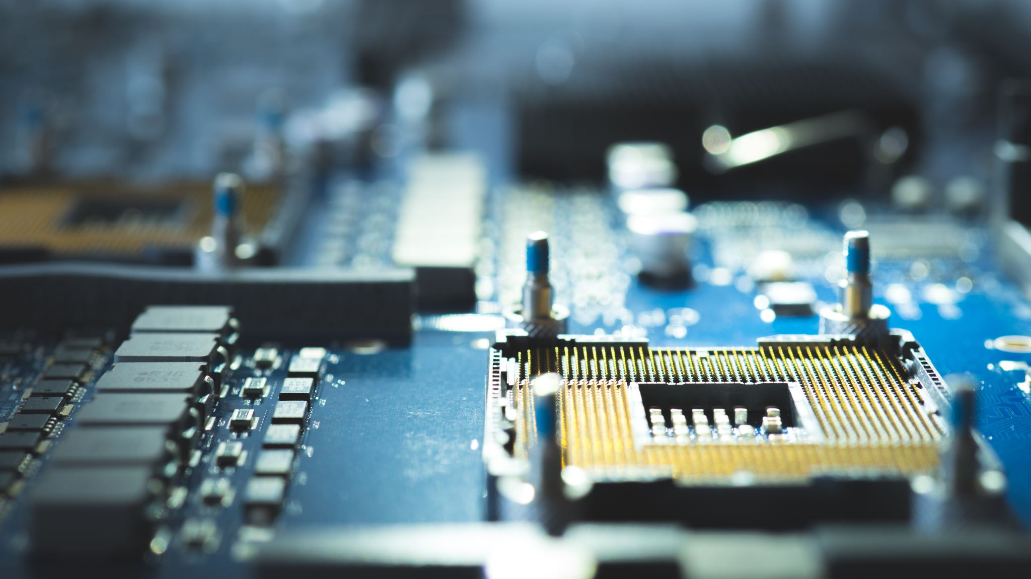
RAM must be FAST.
And it’s faster to just find a random spot in memory, shove the data in, and move on.

Slide 99

Storing Data
When writing a program that takes input from the user, we use: cin >> X;
But... How do we store that input?
cin >> by itself is like taking a note from someone and throwing it away before reading it.

Slide 100
Variable
A variable is a named location where data is stored in memory.
Each Variable has 3 parts:
  Name
  Type
  Value
int age = 25;

Slide 101



Variable
A variable is a named location where data is stored in memory.
Each Variable has 3 parts:
  Name
  Type
  Value
int age = 25;

Slide 102
Variable Type
We must know the type of data that the variable will hold so we can reserve the right amount memory for that value.
int age = 25;

Slide 103
Variable Type
An int takes up 4 Bytes for a single number.
A char needs 1 Byte.
A string needs 1 Byte per char.
“Hello World” needs 11 Bytes
int age = 25;

Slide 104
Variable Declaration
The first step to using a variable is to declare it.
Declaring a variable allows the computer to reserve a spot in memory.
To declare a variable, you just need to put the type and the name.
int age;

Slide 105
Declaring
0x00
0x08
0x10
0x18
0x20
0x28
0x30
0x38
When we declare a variable, the compiler looks at the data type, and reserves space for that data.
An int takes up 4 bytes.

Slide 106
Declaring
0x20
0x28
0x30
0x38
When we declare a variable, the compiler looks at the data type, and reserves space for that data.
An int takes up 4 Bytes.

Slide 107
Variable Assignment
The 2nd step is to assign a value to it.
Here we use the assignment operator (=) to store the value in memory at the location reserved for the variable.
int age;
age = 27;

Slide 108
Assignment Operator
Assigns a value to variables
=
= is NOT a normal equal sign.
string name = ”Miles";
This assigns “Miles” to a variable called name

Slide 109
Assignment
27
0x20
0x28
0x30
0x38
An int takes up 4 Bytes, so the value is stored there.
The first time you assign a value to a variable, it’s called initializing it.

Slide 110
Variable Declaration and Assignment
You can only declare a variable ONCE in a program, but you can assign values as many times as you want.
The location will remain the same, but the value can change.
int age;
age = 27;
age = 28;

Slide 111
Re-assignment
27
0x20
0x28
0x30
0x38
An int takes up 4 Bytes, so the value is stored there.
int age;
age = 27;
age = 28;

Slide 112
Re-assignment
*delete*
0x20
0x28
0x30
0x38
An int takes up 4 Bytes, so the value is stored there.
int age;
age = 27;
age = 28;

Slide 113
Re-assignment
28
0x20
0x28
0x30
0x38
An int takes up 4 Bytes, so the value is stored there.
int age;
age = 27;
age = 28;

Slide 114
Variable Rules Part 1
You must DECLARE a variable before you can assign to it.
You can only declare a variable once.
Your DATA TYPE must match the data that will be assigned.
You must INITIALIZE a variable by assigning it a value before you can use it.
You can reassign values as much as you want.

Slide 115
Variable Rules Part 2
You can’t start a variable name with a number
You can’t use some keywords as variable names (EX: int, string…)
You can declare a variable anywhere within your code, but they tend to be found at the top
Variable names are meant for HUMANS. Computers don’t care, so make sure your variables are named things that make sense
Use camelCase when naming variables.

Slide 116
Variable Example
string username; // Variable Declaration
cin >> username;// Assigning a value
cout << "Hi " << username << endl; // Using a value, gives back input
username = "Billy"; // Reassigning a value
cout << "Hi " << username << endl; // Using a value, gives back "Billy"

Slide 117
Why Data Type matters
0x20
0x28
0x30
0x38
An int takes up 4 Bytes. We reserve that much space.
int age;

Slide 118
Why Data Type matters
b
0x20
0x28
0x30
0x38
If we try to put a string “boats” in there…
Each char is 1 Byte, so “boats” is 5 Bytes.
int age;
age = “boats”;
// ERROR

Slide 119
Why Data Type matters
b
o
0x20
0x28
0x30
0x38
If we try to put a string “boats” in there…
Each char is 1 Byte, so “boats” is 5 Bytes.
int age;
age = “boats”;
// ERROR

Slide 120
Why Data Type matters
b
o
a
0x20
0x28
0x30
0x38
If we try to put a string “boats” in there…
Each char is 1 Byte, so “boats” is 5 Bytes.
int age;
age = “boats”;
// ERROR

Slide 121
Why Data Type matters
b
o
a
t
0x20
0x28
0x30
0x38
If we try to put a string “boats” in there…
Each char is 1 Byte, so “boats” is 5 Bytes.
int age;
age = “boats”;
// ERROR

Slide 122
Why Data Type matters
b
o
a
t
0x20
0x28
0x30
0x38
If we try to put a string “boats” in there…
Each char is 1 Byte, so “boats” is 5 Bytes.
OVERFLOW
int age;
age = “boats”;
// ERROR

Slide 123

Pointers

Slide 124
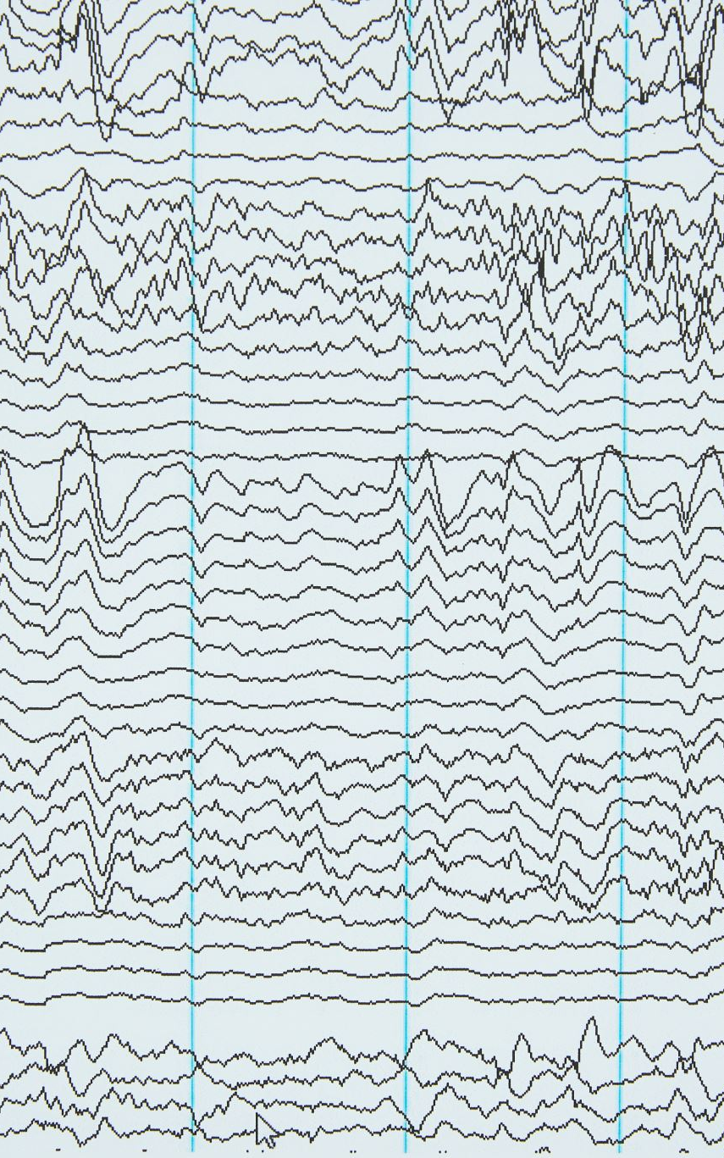
Variable
Technically speaking, variables don’t actually store the value assigned.
Variables are actually pointers.
Pointers… point at where the data is stored, as we have no idea WHERE in memory it’s stored.

Slide 125
Side Note… Pointers
0x00
0x08
0x10
0x18
0x20
0x28
0x30
0x38
When you make a variable, the variable holds a “pointer” to the address that the value is stored in.
int age;
age = 29;

Slide 126
Side Note… Pointers
0x00 ____________
0x08
0x10
0x18
0x20
0x28
0x30
0x38
This will hold an address, but is “age”
Declaring reserves a space in memory to hold an address.
int age;

Slide 127
Side Note… Pointers
0x00 ________
0x08
0x10
0x18
0x20 __________
When you initialize, you reserve your memory for the data.
int age;
age = 29;
0x20 is the address for this chunk, and it’s waiting for a value

Slide 128
Side Note… Pointers
0x00 0x20
0x08
0x10
0x18
0x20 __________
You then save the address of where the data will be stored
int age;
age = 29;

Slide 129
Side Note… Pointers
0x00 0x20
0x08
0x10
0x18
0x20 29
Then the value is stored
int age;
age = 29;

Slide 130
Side Note… Pointers
0x00 0x20
0x08
0x10
0x18
0x20 29
When you CALL the variable…
int age;
age = 29;
Console.Write(age);

Slide 131
Side Note… Pointers
“age” is here…
Where is it pointing?
0x00 0x20
0x08
0x10
0x18
0x20 29
When you CALL the variable…
It checks out the variable…
int age;
age = 29;
Console.Write(age);

Slide 132

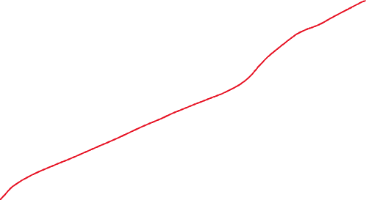

Side Note… Pointers
Oh… it’s pointing at 0x20
0x00 0x20
0x08
0x10
0x18
0x20 29
When you CALL the variable…
It checks out the variable…
Then looks at the address stored.
int age;
age = 29;
Console.Write(age);

Slide 133
Side Note… Pointers
0x00 0x20
0x08
0x10
0x18
0x20 29
It jumps to that location…
int age;
age = 29;
Console.Write(age);
Here’s 0x20…
What’s stored in there?

Slide 134
Side Note… Pointers
0x00 0x20
0x08
0x10
0x18
0x20 29
It jumps to that location…
Then looks at the value stored
int age;
age = 29;
Console.Write(age);
It has 29.
Got it.

Slide 135
Side Note… Pointers
0x00 0x20
0x08
0x10
0x18
0x20 29
It jumps to that location…
Then looks at the value stored
Then it returns that value.
int age;
age = 29;
Console.Write(age);
It has 29.
Got it.

Slide 136
When programming…
Most of the time you can just ignore the pointer stuff. The compiler handles it all for you.
But there are going to be a few times where this is important to understand.

Slide 137
Back to the main topic

Slide 138
Declaration / Initialization at the same time.
You can declare and initialize a variable on the same line.
You can also declare and multiple variables in the same line, but to keep things simple, let’s ignore this.
int x = 5;

Slide 139
Assigning a variable the value of a variable
You can assign a variable the value of a variable. It makes a COPY of it.
X does NOT equal Y here.
X equals the VALUE inside of Y.
int x = 5;
int y = 2;
x = y;

Slide 140

Some examples

Slide 141
Questions
Name the three things all variables have
T/F: Variables must always be declared before being used.
Can you redeclare a variable?
Can you reassign the value of a variable?

Slide 142

Control Structures
AI is secretly just a ton of If statements

Slide 143
Control Structures
Structures that control the flow of a program.
There are multiple structures involved, but the most important for now are conditionals.

Slide 144
if statements
Runs code if a specific condition is met.
The ( ) is where the condition goes. Conditions are either TRUE or FALSE.
if(condition)
{
// Do Stuff
}

Slide 145
if statement example
int x = 10;
if(x > 5)
{
cout << "The number is greater than 5.";
}
Output: The number is greater than 5.

Slide 146
else statements
Runs code if none of the other conditionals are true.
NOTE: Does not have ( condition )
if(condition)
{
// Do Stuff
}
else
{
// Do OTHER Stuff
}

Slide 147
else statement example
int x = 3;
if(x > 5)
{
cout << "The number is greater than 5.";
}
else
{
cout << "The number is 5 or less.";
}
Output: The number 5 or less.

Slide 148
else if statements
if (condition1) {
// Code when condition1 is true
}
else if (condition2) {
// Code when condition2 is true
}
else {
// Code when all conditions are false
}
Allows you to check multiple conditions in sequence.
Checked in order. Once a true condition is found, the corresponding block is executed, and the rest of the conditions are ignored.

Slide 149
else if statement example
int x = 5;
if(x > 10)
{
cout << "The number is greater than 10.";
}
else if(x > 3)
{
cout << "The number is greater than 3.";
}
else
{
cout << "The number is 5 or less.";
}
Output: The number greater than 3.

Slide 150
Conditional “chains”
In a single ”set” of conditionals, you can only ever have 1 if statement and 1 else statement.
You can have an if statement by itself
You cannot have an else statement by itself
You cannot start out with an else if statement.
Once you put another if statement, you start another “chain” of conditions.

Slide 151
Conditional chains example
int x = 10;
if(x > 5)
{
cout << "The number is greater than 5.";
}
if(x > 8)
{
cout << "The number is greater than 8.";
}
Output:
The number is greater than 5.
The number is greater than 8.

Slide 152
Conditional chains BAD example
int x = 10;
else // this is NOT allowed
{
cout << "The number is greater than 5.";
}
Output:
//ERROR

Slide 153
Conditional chains Bad example
int x = 10;
else if(x > 5) // this is NOT allowed
{
cout << "The number is greater than 5.";
}
Output:
//ERROR

Slide 154
Comparison Operators
Compares 2 values and returns a boolean
Examples:
  == (equal to)
  != (not equal to)
  < (less than)
  > (greater than)
  <= (less than or equal to)
  >= (greater than or equal to)
We will come back to these a bit later when we talk about conditional statements.

Slide 155
What will be the output?
int x = 5;
if(x > 10)
{
cout << "The number is greater than 10.";
}
else if(x > 5)
{
cout << "The number is greater than 5.";
}
else
{
cout << "The number is 5 or less.";
}

Slide 156



What will be the output?
int x = 5;
if(x > 10)
{
cout << "The number is greater than 10.";
}
else if(x >= 5)
{
cout << "The number is greater than 5.";
}
else
{
cout << "The number is 5 or less.";
}

Slide 157







What will be the output?
int x = 10;
if(x == 10)
{
cout << "The number is greater than 10.";
}
else if(x >= 5)
{
cout << "The number is greater than 5.";
}
else
{
cout << "The number is 5 or less.";
}

Slide 158





What will be the output?
int x = 10;
if(x >= 5)
{
cout << "The number is greater than 5.";
}
else if(x == 10)
{
cout << "The number is greater than 10.";
}
else
{
cout << "The number is 5 or less.";
}

Slide 159
Nested Conditionals
If, else if, and else statements can be nested inside of each other. It checks the outer most one first, then works it’s way down.
int number = 8;
if (number > 5)
{
if (number < 10)
{
cout << "The number is between 5 and 10.";
}
}

Slide 160
Combining Conditionals
Sometimes you need to check 2 or more things at the same time. You could nest, but the more efficient way is using AND, OR and NOT
if (condition1 && condition2)
{
// Code when both conditions are true
}

Slide 161
Logical Operators – AND (&&)
&& -> AND
  Both sides have to be true for it to run
if (condition1 && condition2)
{
// Code when both conditions are true
}

Slide 162
Logical Operators – AND (&&)
&& -> AND
  Both sides have to be true for it to run
int number = 20;
if (number > 5 && number > 10)
{
cout << "The number is greater than 5 and 10.";
}
Output: The number is greater than 5 and 10.

Slide 163
Logical Operators – OR (||)
|| -> OR
  Either sides (or both) can be true for it to run
if (condition1 || condition2)
{
// Code when either side (or both) is true
}

Slide 164

Logical Operators – OR (||)
|| -> OR
  Either sides (or both) can be true for it to run
int number = 3;
if (number < 5 || number > 10)
{
cout << ”YAY";
}
Output: YAY

Slide 165

Logical Operators – OR (||)
|| -> OR
  Either sides (or both) can be true for it to run
int number = 87;
if (number < 5 || number > 10)
{
cout << ”YAY";
}
Output: YAY

Slide 166


Logical Operators – OR (||)
|| -> OR
  Either sides (or both) can be true for it to run
int number = 8;
if (number < 5 || number > 10)
{
cout << ”YAY";
}
Output: [NONE]

Slide 167
Logical Operators – NOT (!)
! -> NOT
  Inverts the conditional, so it runs when the conditional is false
if (!condition)
{
// Code when the condition is false
}

Slide 168


Logical Operators – NOT (!)
! -> NOT
  Inverts the conditional, so it runs when the conditional is false
bool playerIsAlive = false;
if (!playerIsAlive)
{
cout << ”Game Over";
}
Output: Game Over

Slide 169


Logical Operators – NOT (!)
! -> NOT
  Inverts the conditional, so it runs when the conditional is false
bool playerIsAlive = true;
if (!playerIsAlive)
{
cout << ”Game Over";
}
Output: [NONE]

Slide 170
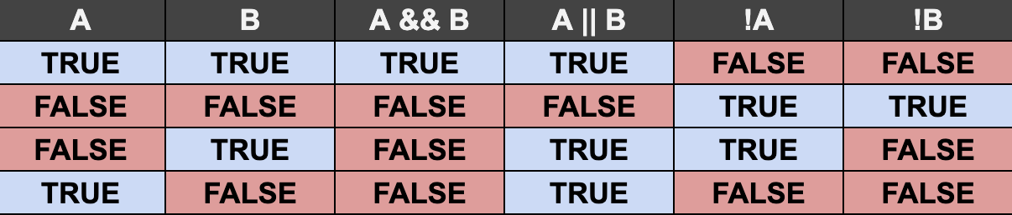
Logical Operators Chart

Slide 171
Best Practices - conditionals
Keep conditions simple: Write conditions that are easy to understand.
Avoid deep nesting: Deeply nested conditions can make your code hard to read.
Use else if when necessary: Use else if when you have multiple mutually exclusive conditions.
Order Matters: When using a “conditional chain”, the order in which you check things matters.
Handle edge cases: Ensure you consider and handle edge cases in your logic.
Space things out!: You should ALWAYS tab things over inside of a code block. (Look at the examples I provided)

Slide 172
Other types of conditionals
If, else if and else are not the only way to handle conditionals. They work almost all the time, so they are the first one you should learn.
You may encounter other types, so let’s briefly cover them.

Slide 173
Ternary operator ( ? : )
Shorthand for if-else.
Only works if you KNOW you will only have 2 options/outcomes.
if(condition) ? expression1:expression2 ;
int age = 18;
string result = (age >= 18) ? "Adult" : "Minor";
cout << result; // Output: Adult

Slide 174
Switch Statements
switch (variable)
{
case value1:
// Code for case 1
break;
case value2:
// Code for case 2
break;
default:
// Code if no cases match
break;
}
Used for multiple conditions based on a single value, typically easier to read than multiple else if statements.
Can’t be applied to all conditionals, so isn’t usually the default to learn first

Slide 175
Switch Statements
char grade = 'B';
switch (grade)
{
case 'A’:
cout << "Excellent!";
break;
case 'B’:
cout << "Good Job!";
break;
case 'C’:
cout << "Fair.";
break;
default:
cout << "Invalid grade.";
break;
}

Slide 176
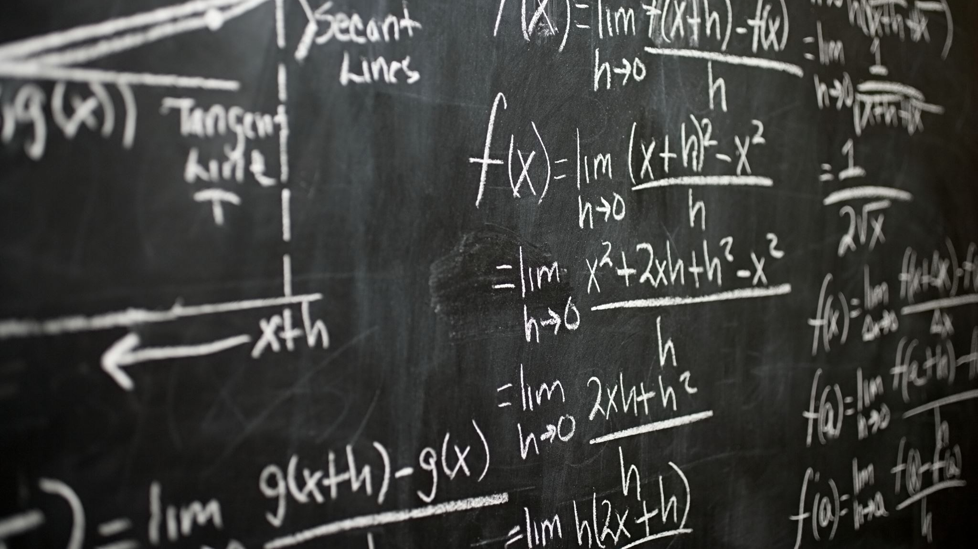
Functions and Methods
They are the same thing but also kind of different which is annoying

Slide 177
Functions
Function: A set of code that can be run later by calling its name.
Think of it like teaching your computer a command.
If you tell a kid to tie their shoes, they have no idea how to do it until you show them step by step (Grab one lace in one hand, and the other in the other…).
But once they have learned it, you simply have to say “Tie your Shoe” and then they know what to do.

Slide 178
Functions
Functions are blocks of code designed to perform a specific task.
They help to organize and reuse code, making it easier to read, maintain, and debug.
void SayHello()
{
cout <<"Hello, World!";
}
SayHello();

Slide 179
Why use Functions?
Code Reusability: Write code once and reuse it whenever needed.
Modularity: Break down complex problems into smaller, manageable tasks.
Readability: Makes the code easier to read and understand.
Maintainability: Easier to update and debug code by isolating functionality.

Slide 180
D.R.Y
Don’t Repeat Yourself
Whenever possible, try to avoid repeating code unnecessarily.
Use functions to take code you would use multiple times and make it easier to maintain.

Slide 181
Function Declaration Syntax
ReturnType: The data type of the value the function returns (e.g., int, void). The actual return goes AT THE END of the codeblock.
FunctionName: A meaningful name for the function.
Parameters: Variables passed to the function (optional).
Body: The block of code that runs when the function is called.
ReturnType FunctionName(ParameterType parameter)
{
// Code to execute
return aValueofTheSameType;
}

Slide 182
Return Types
A function's return type defines the type of value it will send back to the caller.
  Imagine you are using a calculator, and you put in a problem to solve. You would expect something back, right?
Common return types: int, double, float, string, bool, void (when no value is returned).
ReturnType FunctionName(ParameterType parameter)
{
// Code to execute
return aValueofTheSameType;
}

Slide 183


Return Types
int AddNumbers(int a, int b)
{
return a + b;
}
int result = AddNumbers(3, 4);
void SayHello()
{
cout << “Hello, World!";
}
SayHello();

Slide 184
Parameters
Parameters are variables passed into a function to provide input, separated by commas
Parameters allow functions to be flexible and work with different data.
ReturnType FunctionName(type1 parameter1, type2 parameter2)
{
// Code to execute
return aValueofTheSameType;
}

Slide 185
Parameters
void PrintFullName(string firstName, string lastName)
{
cout << “Full Name: “ + firstName + lastName;
}
PrintFullName(”John”, “Doe”);

Slide 186
Calling A Function
To use a function, simply call it by its name and pass any required arguments.
ReturnType FunctionName(type1 parameter1, type2 parameter2)
{
// Code to execute
return aValueofTheSameType;
}
FunctionName(someThing1, something2);

Slide 187
Function Call
int Multiply(int x, int y)
{
return x * y;
}
int product = Multiply(5, 3);
cout << “Product: " + product;
// prints “Product: 15”

Slide 188
Functions Summary
Functions help make your code reusable, organized, and easy to maintain.
Functions have 2 parts
  Declaration: where you set up the function
  Call: where you use the function by calling its name and passing in parameters
The D.R.Y. principle emphasizes reducing code duplication.
Functions have return types that specify the type of data they return.
Parameters allow functions to be dynamic and adaptable.

Slide 189

Debugging

